Slide 1

Generative adversarial networks

Slide 2
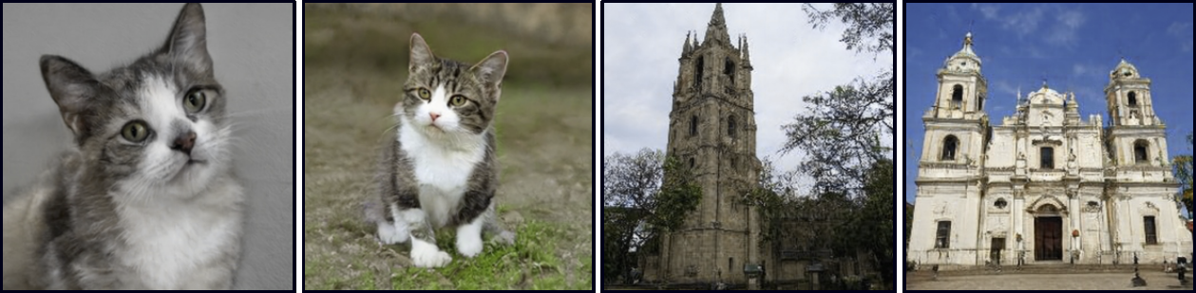
Generative adversarial models

Slide 3
Latent variable models
Latent variable models map a random “latent” variable to create a new data sample
In GANs, this is called the generator:

Slide 4
Generative adversarial models
GAN loss function
DCGAN results and problems
Tricks for improving performance
Conditional GANs
Image translation models
StyleGAN

Slide 5
GAN example

Slide 6
GAN example
Discriminator

Slide 7
GAN example

Slide 8
GAN example

Slide 9
GAN cost function
Discriminator uses standard cross entropy loss:

Slide 10
GAN cost function
Discriminator uses standard cross entropy loss:
Discriminator: generated samples, y = 0, real examples, y = 1:

Slide 11
GAN cost function
Discriminator uses standard cross entropy loss:
Discriminator: generated samples, y = 0, real examples, y = 1:
Generator loss: make generated samples more likely under discriminator (i.e. make discriminator loss larger)

Slide 12
GAN Cost function
Can divide into two parts:

Slide 13
GAN loss function

Slide 14
GAN loss function

Slide 15
GAN loss function

Slide 16
Generative adversarial models
GAN loss function
DCGAN results and problems
Tricks for improving performance
Conditional GANs
Image translation models
StyleGAN

Slide 17
Deep Convolutional (DC) GAN

Slide 18
DC GAN Results

Slide 19
Mode collapse
Training GANs is difficult. Often fails.

Slide 20
GAN training instability

Slide 21
GAN training instability
Fix generator and continue training discriminator, then generator gradients disappear.

Slide 22
Wasserstein GAN loss function
Original function:
Wasserstein GAN:
subject to:

Slide 23
Generative adversarial models
GAN loss function
DCGAN results and problems
Tricks for improving performance
Conditional GANs
Image translation models
StyleGAN

Slide 24
Trick 1: Progressive growing

Slide 25
Trick 2: Minibatch discrimination
Add in statistics across minibatch as input to discriminator
Forces generated batch to have similar variation to real batch

Slide 26
Trick 3: Truncation
Only choose random values of latent variables that are less than a threshold $τ$.

Slide 27
Example results

Slide 28
Interpolation

Slide 29
Generative adversarial models
GAN loss function
DCGAN results and problems
Tricks for improving performance
Conditional GANs
Image translation models
StyleGAN

Slide 30
Conditional GAN models

Slide 31
Conditional GAN models

Slide 32
ACGAN results

Slide 33
Conditional GAN models

Slide 34
InfoGAN results

Slide 35
Generative adversarial models
GAN loss function
DCGAN results and problems
Tricks for improving performance
Conditional GANs
Image translation models
StyleGAN

Slide 36
Image translation: Pix2Pix

Slide 37
Image translation: Pix2Pix

Slide 38
Image translation: SRGAN

Slide 39
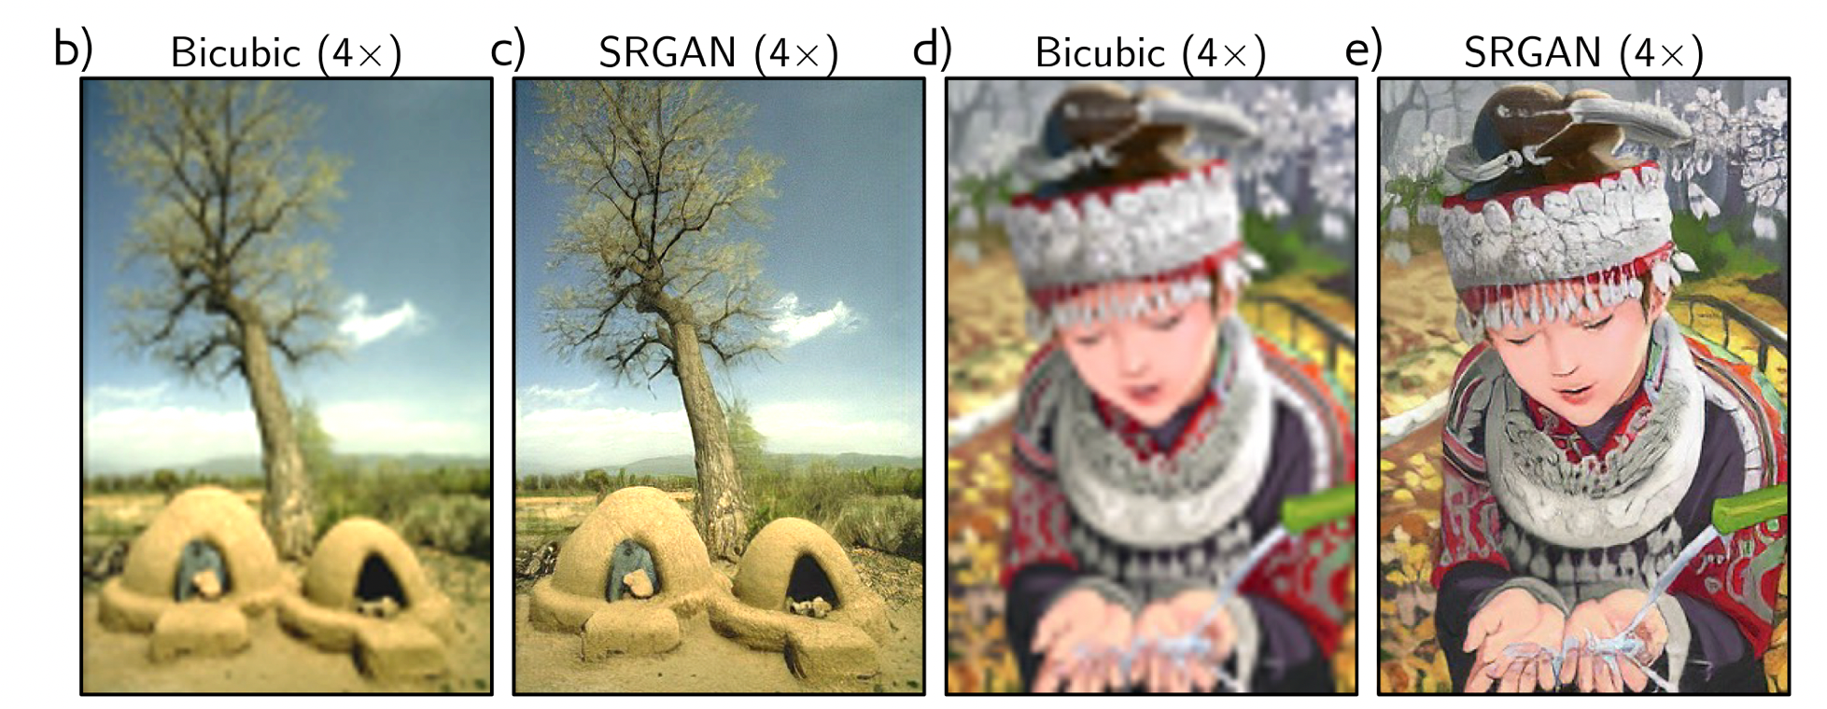
Image translation: SRGAN

Slide 40
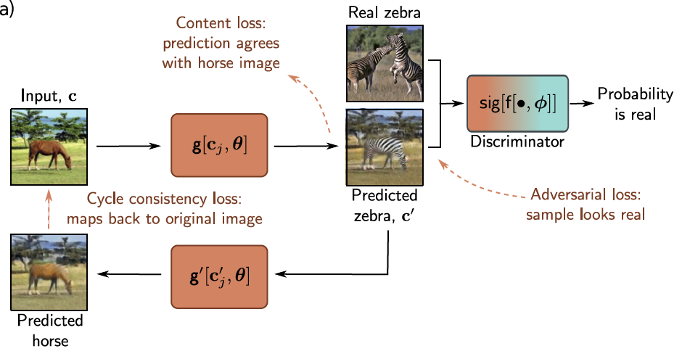
Image translation: CycleGAN

Slide 41
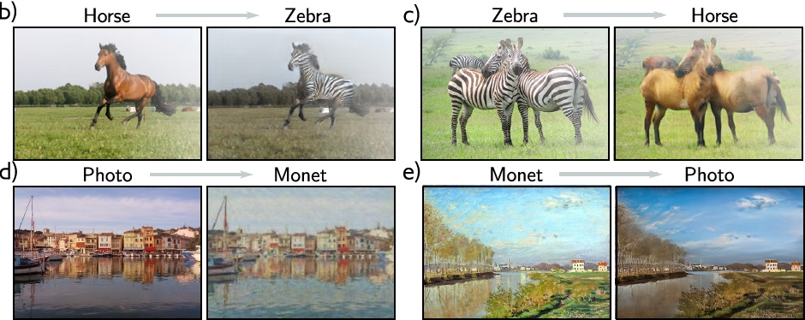
Image translation: CycleGAN

Slide 42
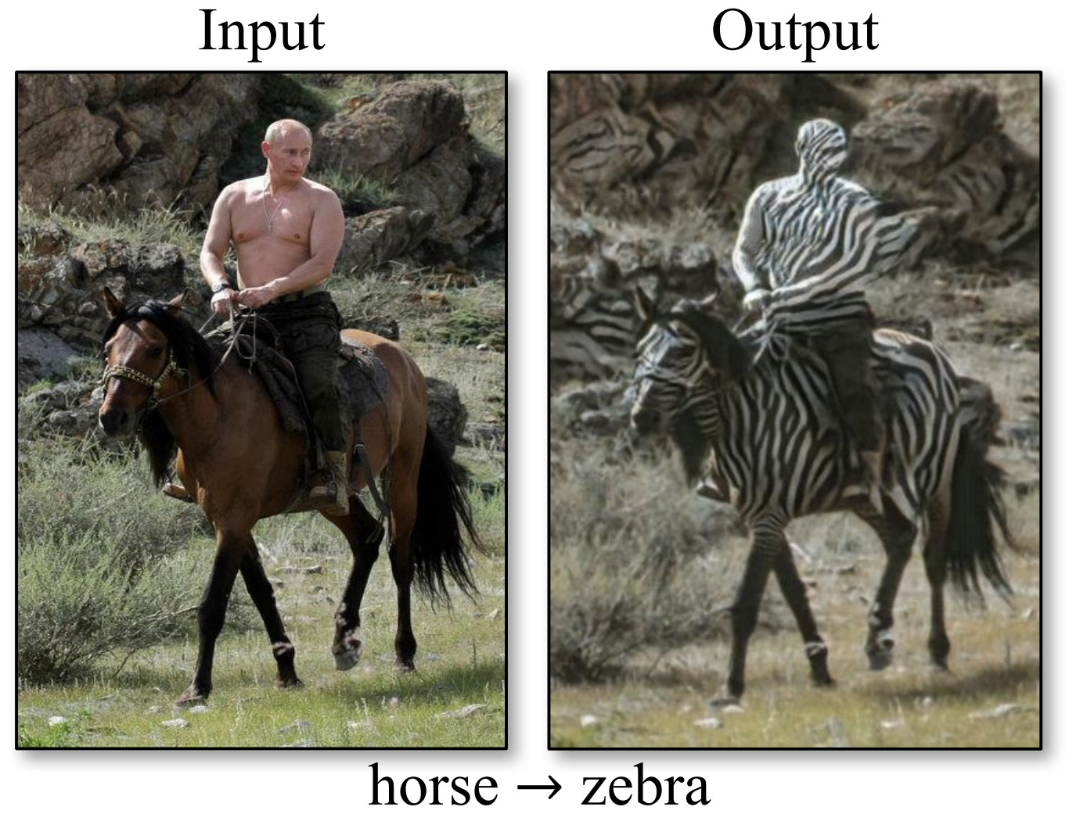

Slide 43
Generative adversarial models
GAN loss function
DCGAN results and problems
Tricks for improving performance
Conditional GANs
Image translation models
StyleGAN

Slide 44
Style GAN

Slide 45
Style GAN results

